Slide 1
United Airlines Analytical Exercise
Analyst – Technical Operations Analytics
09/14/2022
Abdul Hannan

Slide 2
Initial Thoughts
27860 X 258 - rows x columns.
Type of Data.
Missing Values.

Slide 3

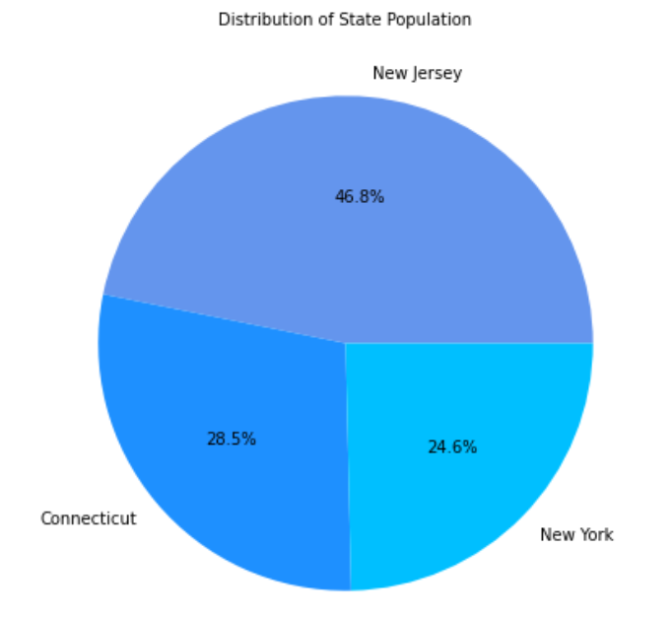
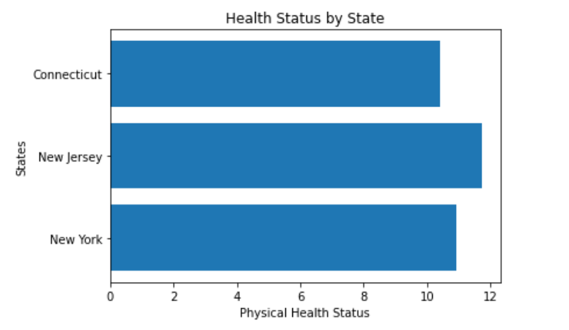
1) Health Status by State
Most populous state is New Jersey.
Imbalance within states, however the distributions are not far apart.
New Jersey
New York
Connecticut

Slide 4
2). Is it statistically significant?
What is P-Value?
Threshold = 0.05
Research Hypothesis: There is a statistical significance between the states. (P < Threshold).
Null Hypothesis: There is no statistical significance between the states. (P > Threshold).
P – Value = 0.0000057 (between all 3 states)
Conclusion: The difference between states is statistically significant.

Slide 5
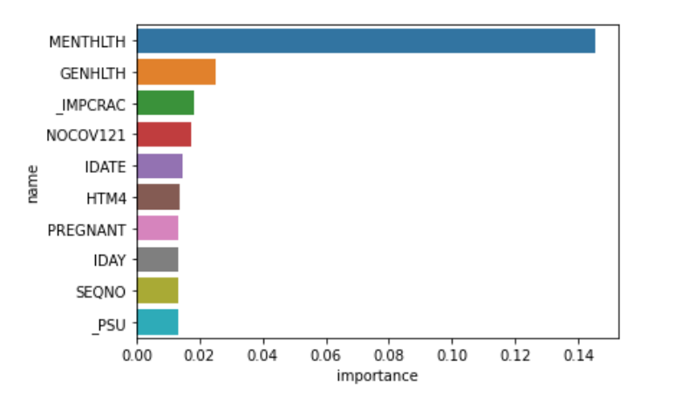
3). Top Predictors?
1. MENTHLTH - Mental Health
2. GENHLTH - General Health
3. _IMPCRAC - Imputed Child Race/Ethnicity
4. NOCOV12 - In the PAST 12 MONTHS, time you did NOT have ANY health insurance or coverage?
5. IDATE - Interview Date

Slide 6
4). If more time was given, what else would I have done?
Deal with categorical data.
Work on balancing the imbalanced variables.
Standardization.
Principle Component Analysis.

Slide 7
Thank you! Discussion time

